Slide 1
US Healthcare Basics
Day 1
Feb 17, 2021
Trainer
Sameer Tuladhar

Slide 2
US Healthcare from a Global Perspective
Analysis highlights in a series of Commonweath Fund cross-national comparisons that uses health data from the Organization for Economic Co-operation and Development (OECD) to access US Healthcare System
Reference: https://www.commonwealthfund.org/publications/issue-briefs/2020/jan/us-health-care-global-perspective-2019

Slide 3
Highlights
The U.S. spends more on health care as a share of the economy — nearly twice as much as the average OECD country — yet has the lowest life expectancy and highest suicide rates among the 11 nations.
The U.S. has the highest chronic disease burden and an obesity rate that is two times higher than the OECD average.
Americans had fewer physician visits than peers in most countries, which may be related to a low supply of physicians in the U.S.
Americans use some expensive technologies, such as MRIs, and specialized procedures, such as hip replacements, more often than our peers.
Compared to peer nations, the U.S. has among the highest number of hospitalizations from preventable causes and the highest rate of avoidable deaths.
The U.S. outperforms its peers in terms of preventive measures — it has the one of the highest rates of breast cancer screening among women ages 50 to 69 and the second-highest rate (after the U.K.) of flu vaccinations among people age 65 and old

Slide 4
U.S. Spends more on Health Care than any other countries
Data: OECD Health Statistics 2019
Commonwealthfund.org

Slide 5
U.S. Public Spending is similar to Other Countries; Out-of-Pocket and Private Spending are Higher than most
Data: OECD Health Statistics 2019
Commonwealthfund.org

Slide 6
U.S. has the Lowest Life Expectancy
Data: OECD Health Statistics 2019
Commonwealthfund.org

Slide 7
U.S. Adults have the Highest Suicide Rates and Chronic Disease Burden
Suicide Rates
Chronic Disease Burden
Data: OECD Health Statistics 2019
Commonwealthfund.org

Slide 8
Americans visit the Doctor less frequently and have fewer Physicians
Average physician visits per capita, 2017
Practicing physicians per 1000 population, 2018
Data: OECD Health Statistics 2019
Commonwealthfund.org

Slide 9
U.S. has a high rate of MRI Scans
Magnetic Resonance Imaging(MRI) scans per 1000 population
Data: OECD Health Statistics 2019
Commonwealthfund.org

Slide 10
U.S. has among the highest rates of Hospitalizations from Preventable Causes like Diabetes and Hypertension
Discharges per 100,000 population
Data: OECD Health Statistics 2019
Commonwealthfund.org

Slide 11
U.S. has the highest rate of Avoidable deaths
Deaths per 100,000 population
Data: OECD Health Statistics 2019
Commonwealthfund.org

Slide 12
Introduction to the U.S. Healthcare System
Reference: https://www.khanacademy.org/partner-content/brookings-institution/introduction-to-healthcare

Slide 13
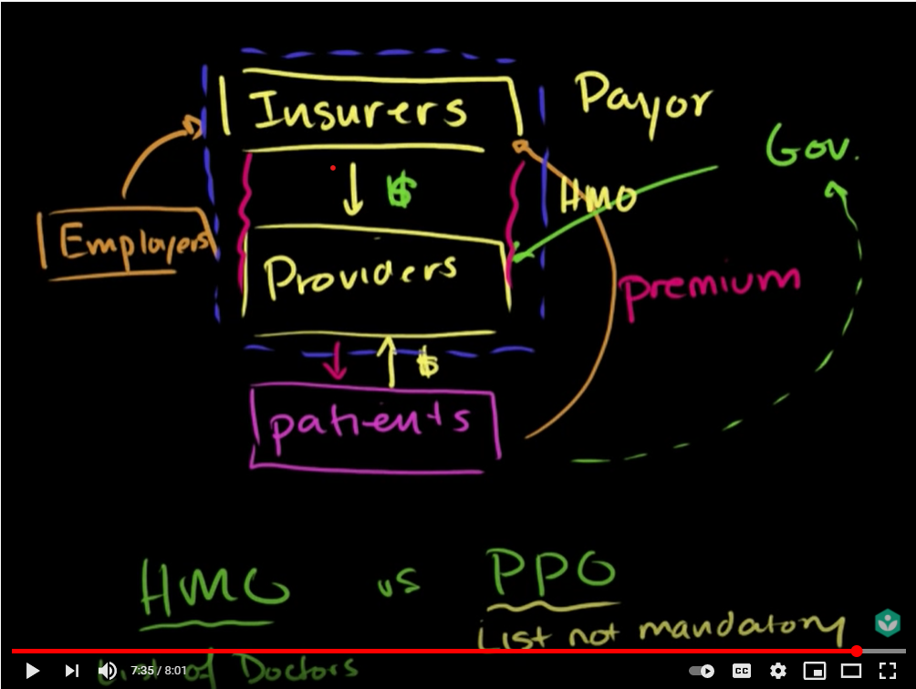
U.S. Healthcare System Overview: Market Players

Slide 14
U.S. Healthcare System: Introduction and complexity

Slide 15
Assignment 1.
1. Based on the learnings in Day 1 session, summarize your understanding on why US healthcare is complex and how patient gets the medical facilities/treatment in US Healthcare System, what are the major players of the US healthcare market involved in provided the medical as well as financial(insurance) services. Write concisely in 1000 words.

